Slide 1

Measuring Party Affinity and Trends in Ranked-Choice Elections
By Michael Peeler

Slide 2
Ranked-Choice Elections

Slide 3
The Anti-Red, Green Circle Party Freedom! Happiness! Friendship!
Blue Circle Party
Red Hexagon Party
Yellow Square Party
Notes:
Next level breakdown into these four key elements: first three represent the academic experience with the fourth

Slide 4

Notes:
Next level breakdown into these four key elements: first three represent the academic experience with the fourth

Slide 5
1
4
3
2
Notes:
Next level breakdown into these four key elements: first three represent the academic experience with the fourth

Slide 6
Measures

Slide 7

Spectrum
P
$$\frac{ }{ + }$$
P
P
2
4
3
1
Notes:
FULL DEFINITION: The Furman Advantage guarantees every student an unparalleled education that combines classroom learning with real-world experiences and self-discovery. This integrated four-year pathway, guided by a diverse community of mentors, prepares students for lives of purpose and accelerated career and community impact— demonstrating in concrete terms the value of a Furman education.

Slide 8


Spectrum
11
$$\frac{ }{ + }$$
= 0.58
8
11
1
$$\frac{ }{ + }$$
= 0.05
19
1
Notes:
FULL DEFINITION: The Furman Advantage guarantees every student an unparalleled education that combines classroom learning with real-world experiences and self-discovery. This integrated four-year pathway, guided by a diverse community of mentors, prepares students for lives of purpose and accelerated career and community impact— demonstrating in concrete terms the value of a Furman education.

Slide 9
Spectrum
11
$$\frac{ }{ + }$$
= 0.58
8
11
1
$$\frac{ }{ + }$$
= 0.05
19
1
Notes:
FULL DEFINITION: The Furman Advantage guarantees every student an unparalleled education that combines classroom learning with real-world experiences and self-discovery. This integrated four-year pathway, guided by a diverse community of mentors, prepares students for lives of purpose and accelerated career and community impact— demonstrating in concrete terms the value of a Furman education.

Slide 10
Adjacency Matrices
Main diagonal counts ballots with no second preference
Notes:
FULL DEFINITION: The Furman Advantage guarantees every student an unparalleled education that combines classroom learning with real-world experiences and self-discovery. This integrated four-year pathway, guided by a diverse community of mentors, prepares students for lives of purpose and accelerated career and community impact— demonstrating in concrete terms the value of a Furman education.

Slide 11
Adjacency Matrices
1 | 14 | 10 | 6
13 | 2 | 7 | 0
4 | 8 | 1 | 11
1 | 13 | 19 | 2
Main diagonal counts ballots with no second preference
Notes:
FULL DEFINITION: The Furman Advantage guarantees every student an unparalleled education that combines classroom learning with real-world experiences and self-discovery. This integrated four-year pathway, guided by a diverse community of mentors, prepares students for lives of purpose and accelerated career and community impact— demonstrating in concrete terms the value of a Furman education.

Slide 12
Our Research

Slide 13
Work from Previous Researchers
Marc D’Avanzo
Used 2019 ballot data
Spectrum between Liberal and Labor
Connor Clark
Generalization of spectrum
Interactive console capability
Found highest standard deviations
Charles Dugaw
Analyzing voter behavior
Do voters follow party advice?
What causes ballot informality?

Slide 14
My Work
Optimized code
 | 1 Spectrum | All Pairings (1,176 Spectra)
Marc & Connor | ~ 20 minutes | ~ 400 hours
Optimizations | ~ 1 minute | ~ 30 minutes
Speed-Up | 2,000% | 120,000%

Slide 15
My Work
Optimized code
 | File Access Time | Space
Marc & Connor | O (n ) | O (1)
Optimizations | O (1) | O (n )
n = Number of spectra
Assumes constant number of ballots and parties competing

Slide 16
My Work
Optimized code
Abstracted spectrum calculations
Created standardized interfaces
public interface DataInterface() {...}
public interface ElectionResources() {...}
public class BallotStream() {
public BallotStream(DataInterface data, ElectionResources elecInfo) {...}
...
}

Slide 17
My Work
Optimized code
Abstracted spectrum calculations
Created standardized interfaces
Implemented the interfaces for 5 new elections
Australia Senate 2019
Australia Senate 2016
Australia Senate 2022
New South Wales Upper House 2015
New South Wales Upper House 2019
New York City Primary 2021
53,321,846 Ballots
321,722,783 Preferences
Total:

Slide 18
My Work
Optimized code
Abstracted spectrum calculations
Created standardized interfaces
Implemented the interfaces for 5 new elections
Created adjacency matrix capability

Slide 19
My Work
Optimized code
Abstracted spectrum calculations
Created standardized interfaces
Implemented the interfaces for 5 new elections
Created adjacency matrix capability
Implemented ability to group parties

Slide 20
My Work
Optimized code
Abstracted spectrum calculations
Created standardized interfaces
Implemented the interfaces for 5 new elections
Created adjacency matrix capability
Implemented ability to group parties
Increased console functionality

Slide 21
My Work
Optimized code
Abstracted spectrum calculations
Created standardized interfaces
Implemented the interfaces for 5 new elections
Created adjacency matrix capability
Implemented ability to group parties
Increased console functionality
Automatic calculations based on matrices and spectra

Slide 22
Results

Slide 23
Adjacency Matrices
Liberal or Labora
Unnamed / Ind.
Parliamentarya
Minor
Liberal or Labor
(A) Second Preference (A)
14.50 % | 33.92 % | 47.52 % | 0.85 %
31.00 % | 23.48 % | 39.13 % | 4.30 %
19.53 % | 23.66 % | 51.20 % | 2.38 %
12.37 % | 22.38% | 47.85% | 13.97 %
Parliamentary
First Preference
Minor
Unnamed / Ind.
Numbers in main diagonal indicate choice of a different member of the same group.
Notes:
FULL DEFINITION: The Furman Advantage guarantees every student an unparalleled education that combines classroom learning with real-world experiences and self-discovery. This integrated four-year pathway, guided by a diverse community of mentors, prepares students for lives of purpose and accelerated career and community impact— demonstrating in concrete terms the value of a Furman education.

Slide 24
Adjacency Matrices
Liberal or Labora
Unnamed / Ind.
Unnamed / Ind.
Parliamentarya
Minor
Liberal or Labor
Parliamentary
Minor
Liberal or Labor
(A) Second Preference (A)
Ranked Another Anywhere
14.50 % | 33.92 % | 47.52 % | 0.85 %
31.00 % | 23.48 % | 39.13 % | 4.30 %
19.53 % | 23.66 % | 51.20 % | 2.38 %
12.37 % | 22.38% | 47.85% | 13.97 %
32.85 % | 81.17 % | 93.64 % | 17.38 %
72.21 % | 65.09 % | 93.85 % | 24.54 %
59.13 % | 74.61 % | 94.53 % | 19.17 %
53.69 % | 72.84% | 88.91% | 24.91 %
Parliamentary
First Preference
First Preference
Minor
Unnamed / Ind.
Numbers in main diagonal indicate choice of a different member of the same group.
Notes:
FULL DEFINITION: The Furman Advantage guarantees every student an unparalleled education that combines classroom learning with real-world experiences and self-discovery. This integrated four-year pathway, guided by a diverse community of mentors, prepares students for lives of purpose and accelerated career and community impact— demonstrating in concrete terms the value of a Furman education.

Slide 25
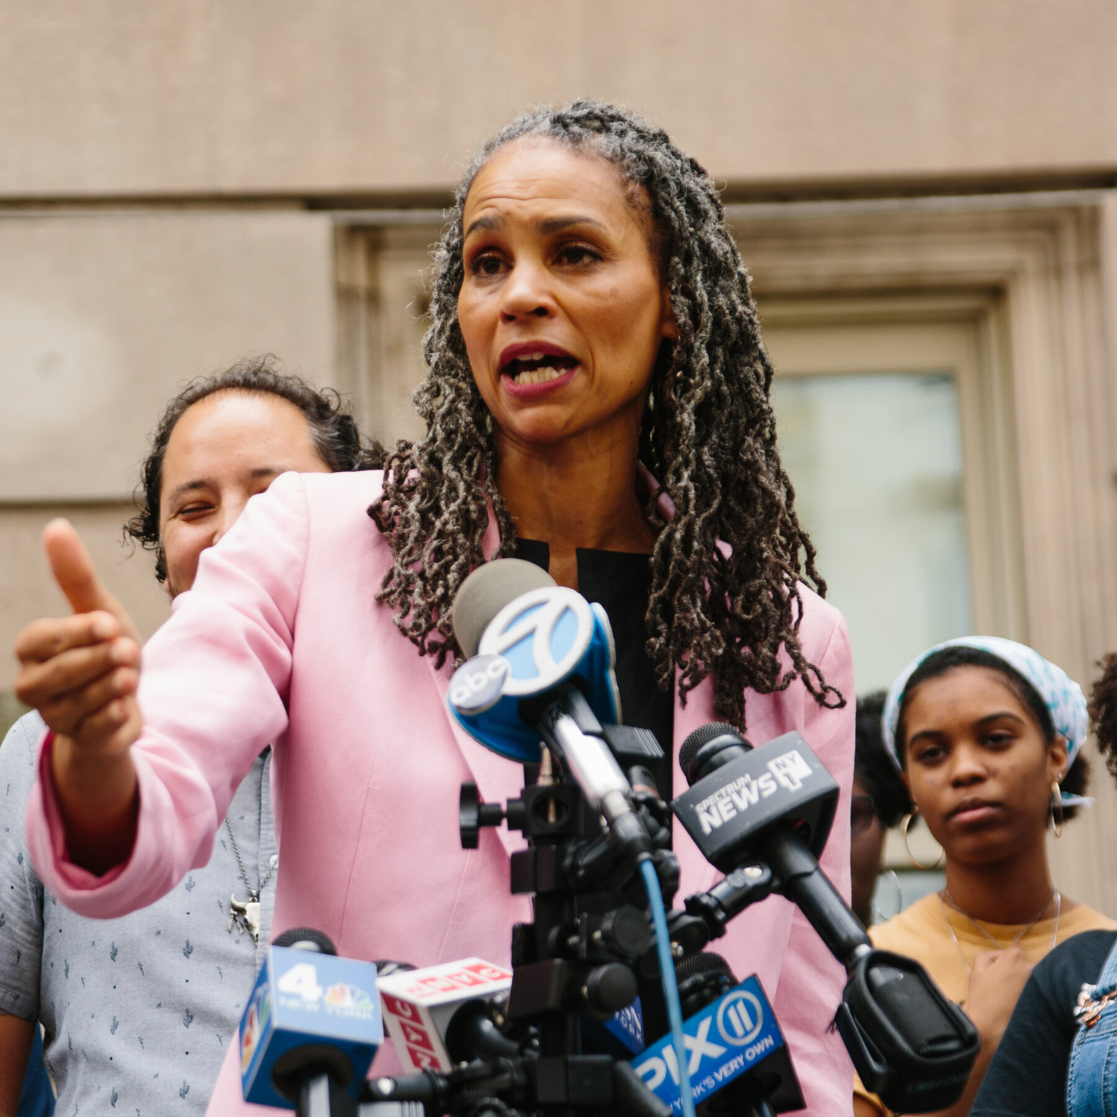


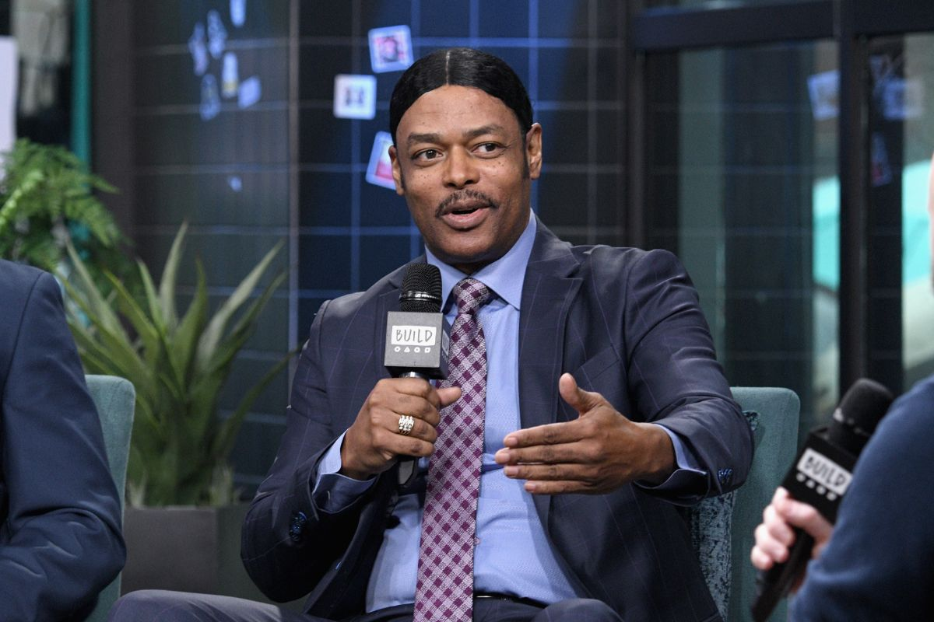

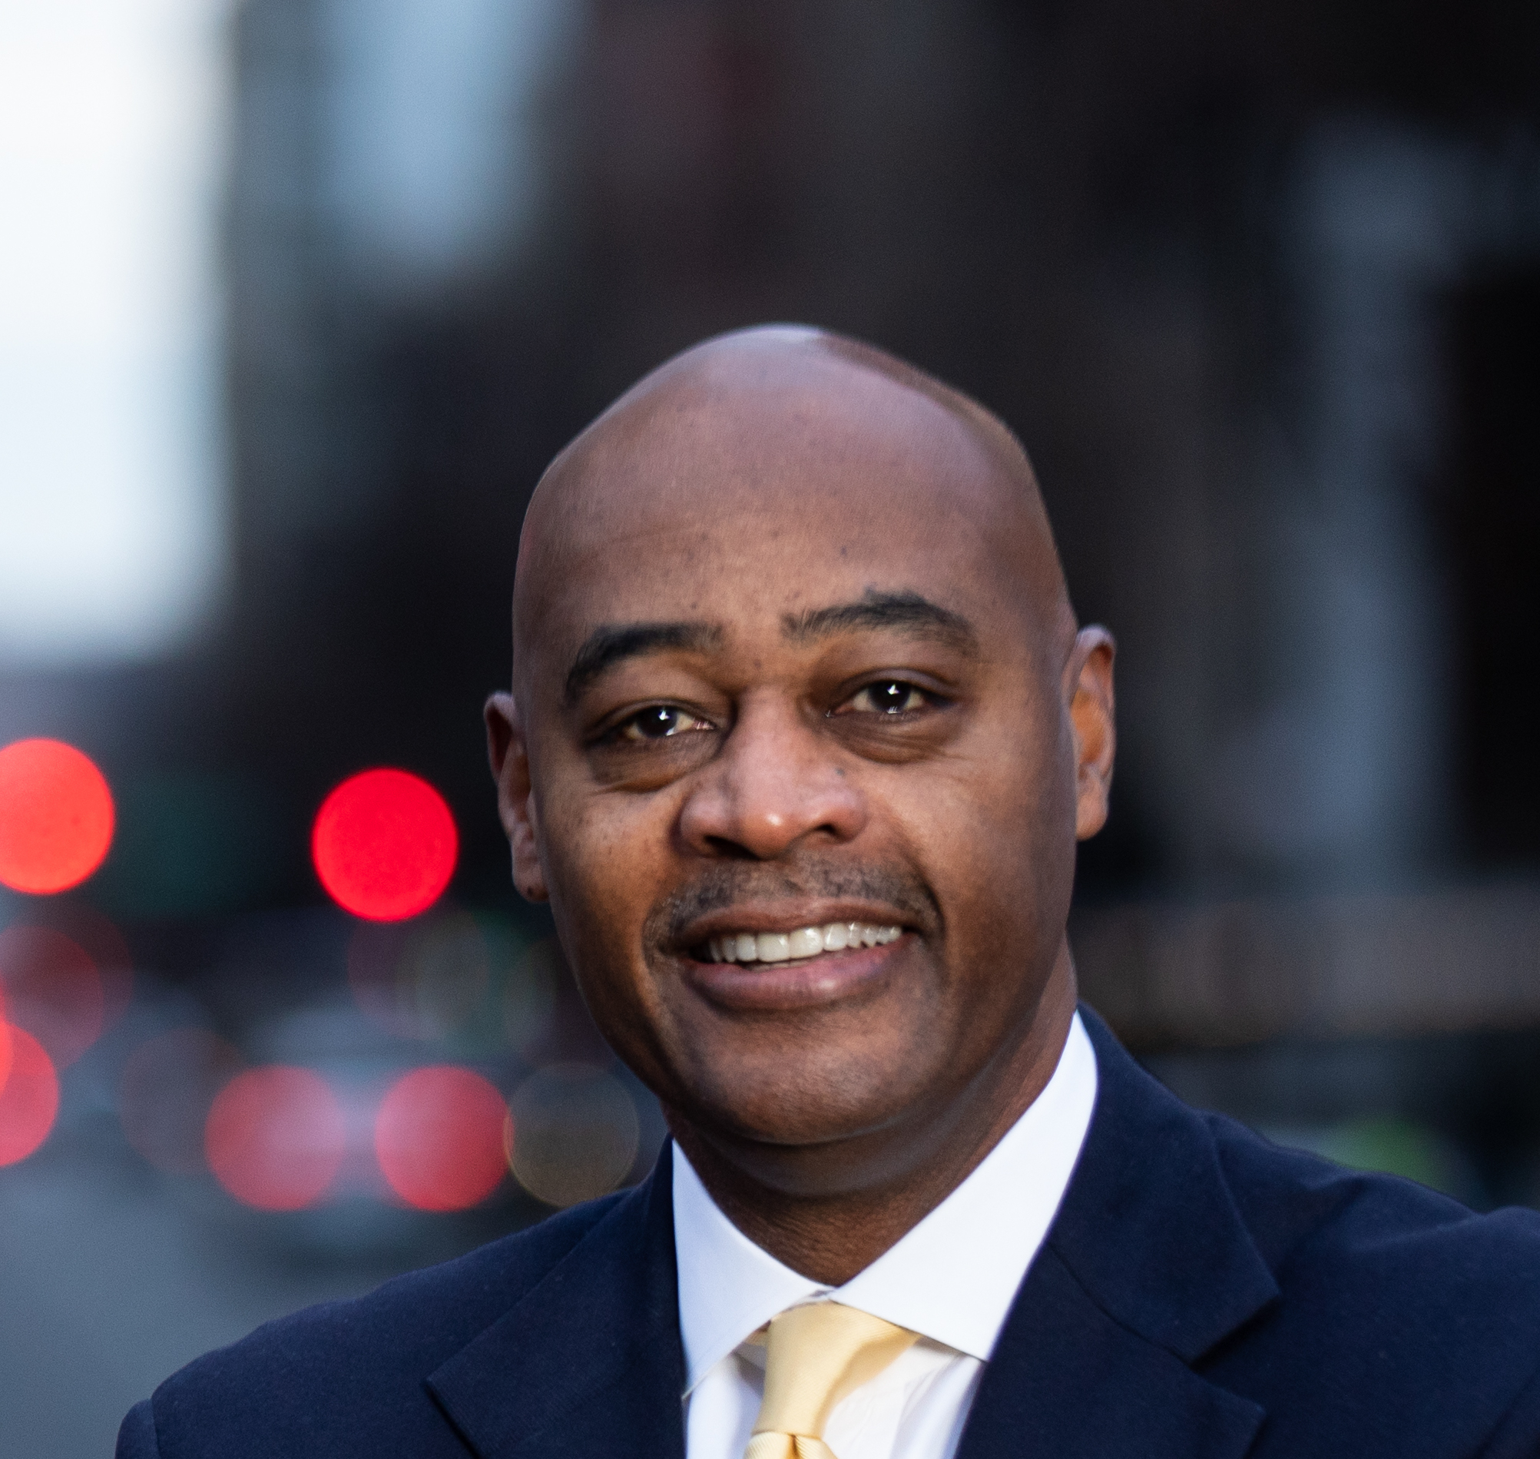
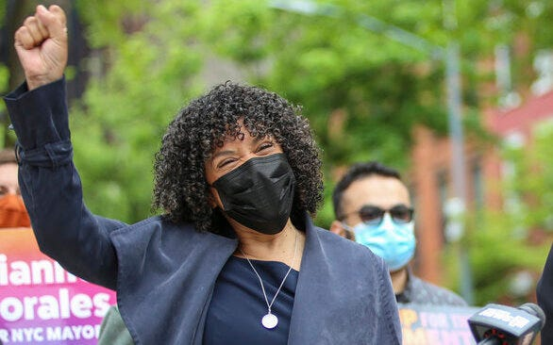
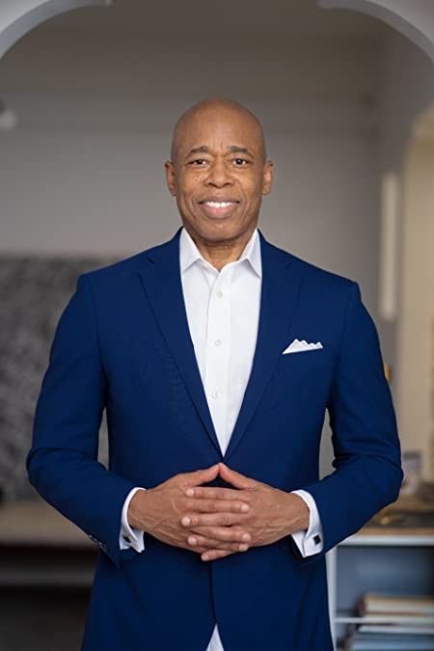
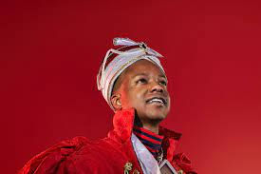

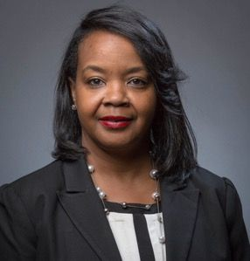
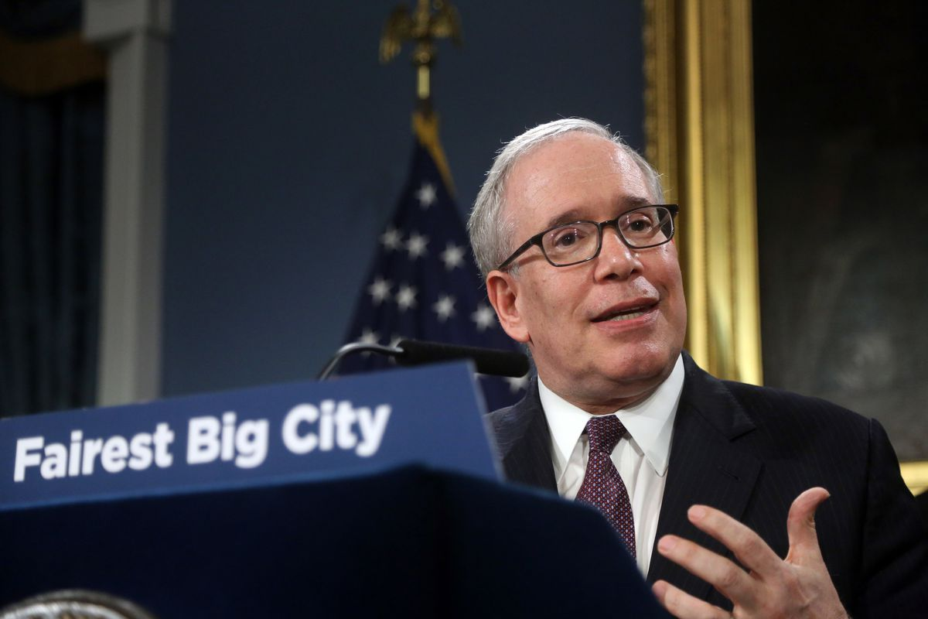
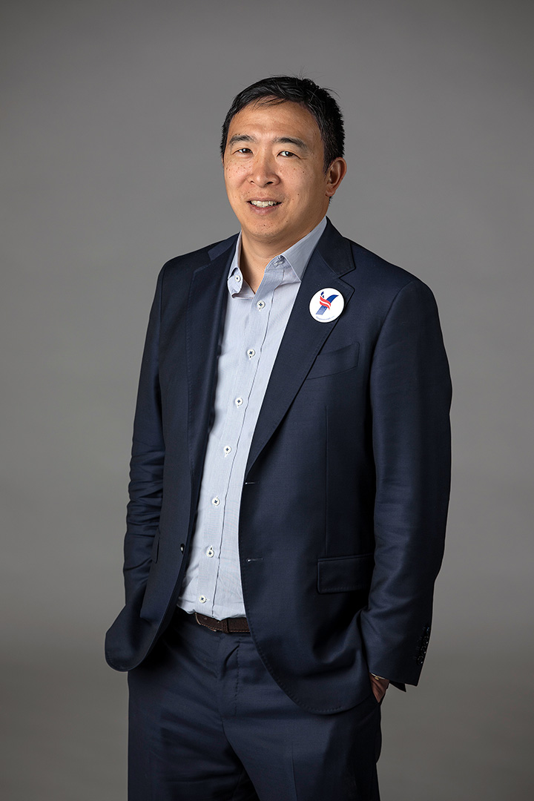
NYC Mayoral Primary Spectrum
Kathryn Garcia
Shaun Donovan
Raymond McGuire
Maya Wiley
Art Chang
Isaac Wright
Dianne Morales
Eric Adams
Write-In
“[Morales is] one of the most progressive candidates in the race.”
– New York Daily News
“A moderate Democrat… in deep blue New York City.”
– Associated Press
Paperboy Love Prince
Aaron Foldenauer
Joycelyn Taylor
Scott Stringer
Andrew Yang
Highest Standard Deviation: 0.2809

Slide 26
Cross-Electorate Results

Slide 27
Conclusions & Future Work

Slide 28
Notes:
Next level breakdown into these four key elements: first three represent the academic experience with the fourth

